Slide 1
2D Kinematics Locomotion System to Analyze Effects of Therapy in Spinal Cord Injury Rodent Models
April 18th, 2009
NASA Symposium
Robbia Hendrix
Barrett The Honors College
Center for Adaptive Neural Systems
Special Thanks to Dr. Ranu Jung and Mallika Fairchild
Harrington Bioengineering Dept, ASU

Slide 2
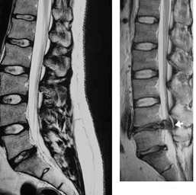
Spinal Cord Injuries:
-12,000 new cases each year in the United States
-Average age of a SCI patient is 39.5 years
-77.8% of SCI are in males
-Etiology: -42% of SCI were caused from motor vehicle crashes
-27.1% from falls
-15.3 from gun shot .
*Data collected 2005, Nat’l SCI Statistical Center, copyright 1998-2008
*Image of SCI © 2008
http://www. justicedeserved.com
Notes:
Purpose for study: Statistics show that average age is about 40 years old, which is relatively young, and the life span of a SCI patient is relatively the same as someone without. Thus, it would make sense to improve the quality of life for SCI patients, which validates the necessity of SCI research.

Slide 3
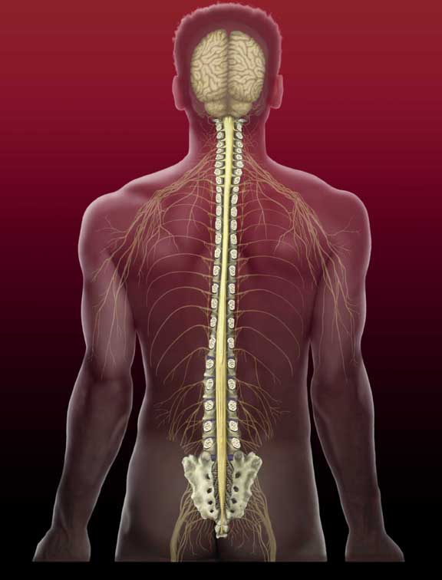
What is a spinal cord injury?
A traumatic lesion on the spinal cord, which results in a series of motor function and sensory impairment.
Two types of injury:
-Incomplete
-Complete
*Cedars-Sinai Health Systems, © 2000-0009
Notes:
Incomplete-symptoms: paraplegia, loss of sensation and/or movement of legs, bowel, bladder, and sexual region
Complete-Symptoms: complete loss of sensory and function below injury site, i.e. paraplegic, tetraplegia

Slide 4
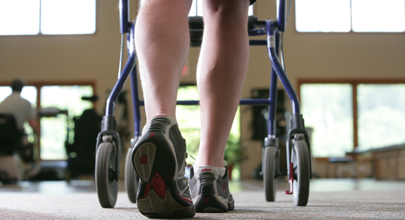
SCI Recovery
∙ No cure at this time, but research* in animal models and humans show that rehabilitation therapies can help improve sensation and motor functionality
*Hope Network Rehabilitation Services
In this particular study, rodent models are used to measure the effectiveness of Treadmill Training (TT) and Functional Neuromuscular Stimulation (FNS) on gait
*James V. Lynskey, PhD, PT, Adam Belanger, MS, Ranu Jung, PhD. “Activity-dependent plasticity in spinal cord injury.” Journal of Rehabilitation Research and Development, Vol 45: 2008.
Notes:
Discusss what promoting plasticity is: The term plasticity is coined to describe a “biological phenomenon.” Specifically in response to an injury, the brain and nervous system will constantly rengotiate and alter their neural pathways and synapses. FNS and Treadmill training have been shown to help with this.

Slide 5
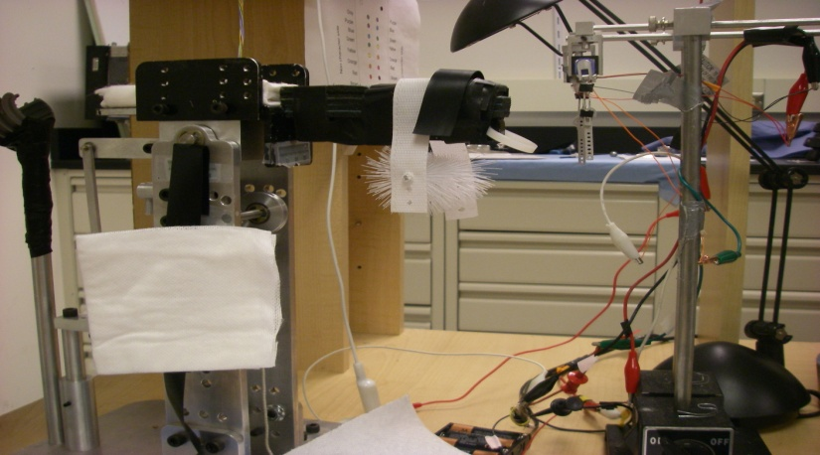
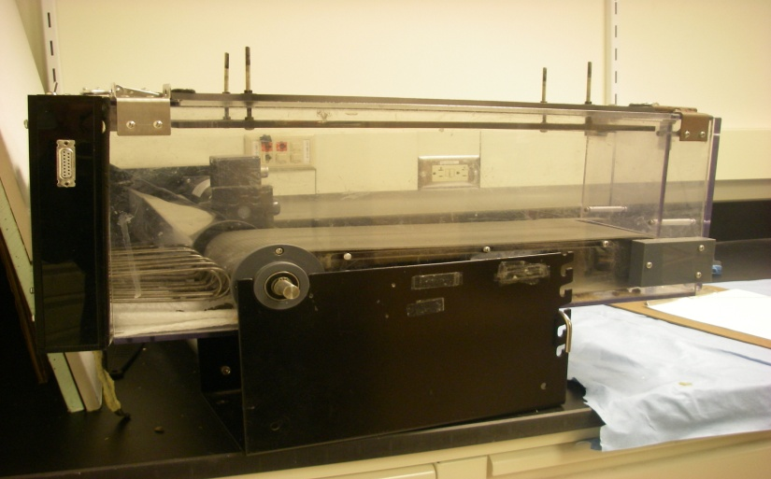
Methods of Rehabilitation
FNS (Functional Neuromuscular Stimulation)
-Electrical stimulation of nerves using intramuscular electrode implantation
TT (Treadmill Training)
- Rodent models run on treadmill
Rodent placed here
Source of electrical current, connected to head connector on rat
Rodent Model runs here
Notes:
FNS-passes electrical current through electrodes into skeletal muscle fibers of hips and knee joints. This excites motor neurons below injury site and sends action potential across axons to eventually reach the synaptic motor-endplate connection to skeletal muscle fibers. This event can act as an intact nervous system by generating muscle force.

Slide 6
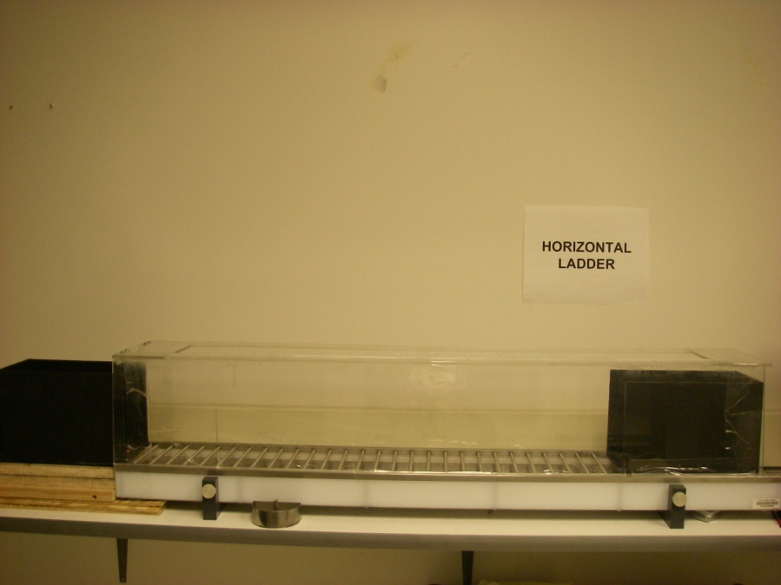
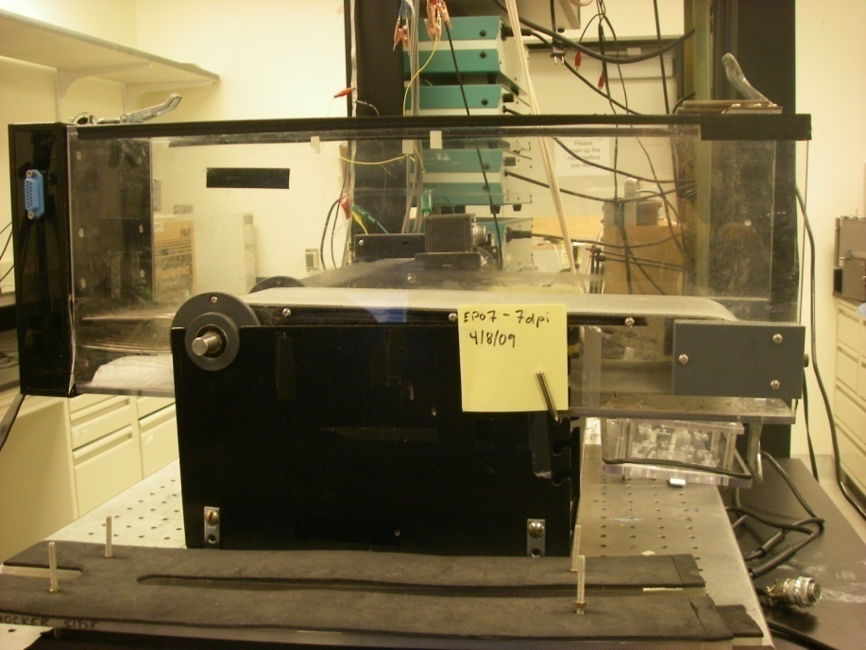
Methods of Assessment
Four methods to measure effectiveness of the therapies:
3D Kinematics
Horizontal Ladder
Measures rodents sensorimotor ability, walks across ladder rungs
Uses 4 video cameras to capture the 3D movement of joints
Rat passes both directions

Slide 7
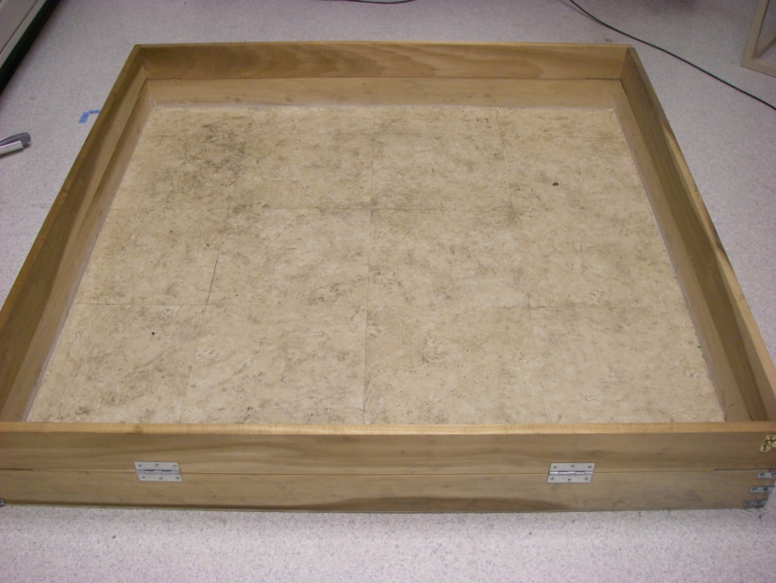
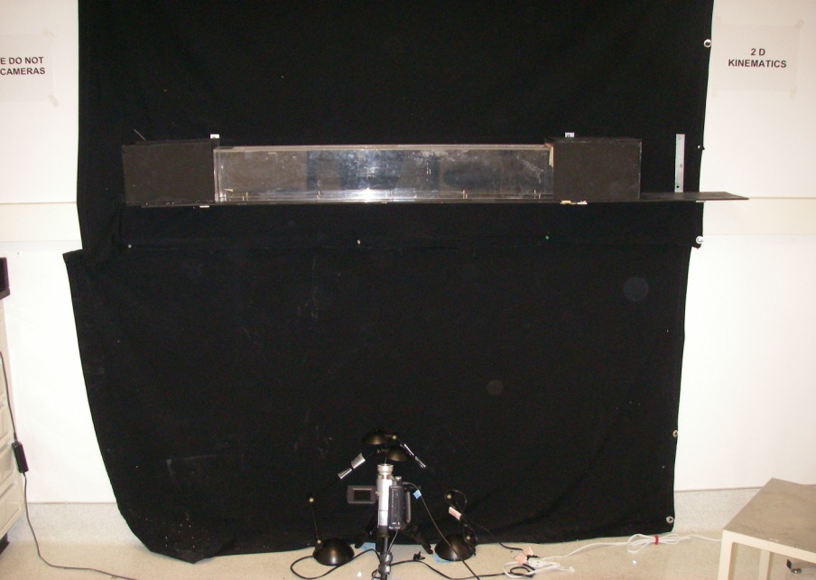
2D Kinematics
(Focus of Presentation)
BBB (Basso, Beattie, Breshnahan Locomotor Rating Scale)
Measures the daily locomotor function of rodent in open field
Measures 2D overground locomotion
One time across is one pass
Camera view

Slide 8
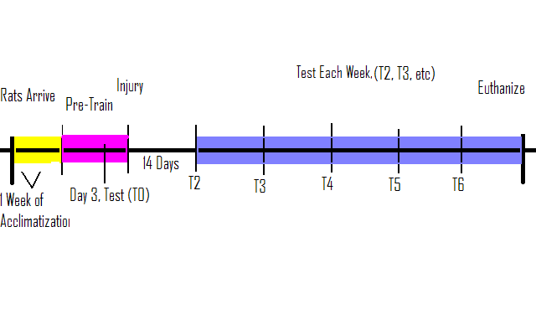
2D Kinematics Overground Locomotion
- Reflective markers are placed on the right and left ball of paws and heels, and center of belly
- Camera below captures 2D image of passes
- Data captured for each rat, each week is analyzed with programs Adobe Premier, Peak Motus, and Matlab
Timeline
Timeline

Slide 9
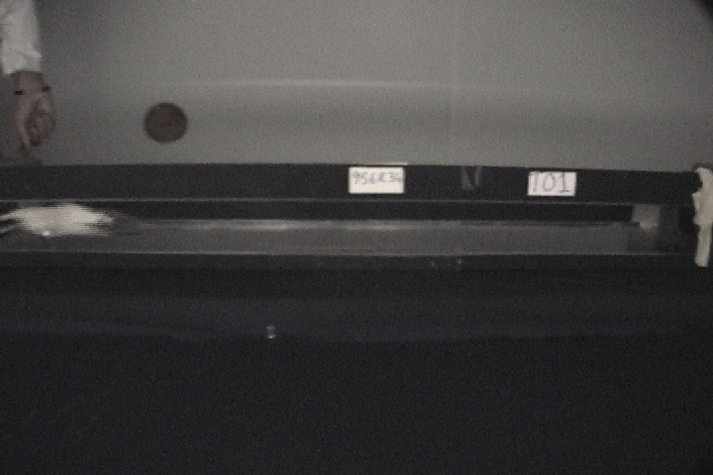
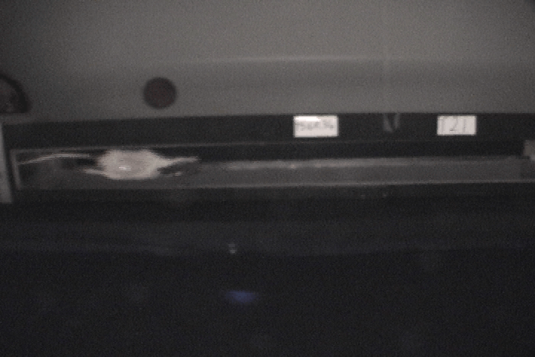
2D Kinematics Video Capture
Pre-injury (T0)
14 Days Post Injury (T2)

Slide 10
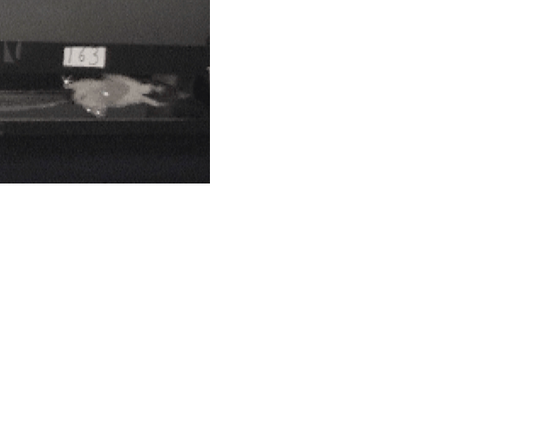
Variables of 2D Kinematics
b
d
C
a
Velocity
Limb Rotation- Left + Right Hindlimb Angles (a+b)
Stance Width- Distance Between Limbs (c)
Stride Length- Heel Strike to Heel Strike (d)
Velocity is also measured

Slide 11
Results (Examples)
n= 1 NT, 1 TT, 1 FNS
Average Stance Width
Angle
-For stance width, FNS and TT are more level throughout, while NT peaks at 5cm.
-This shows that these FNS and TT rodents are negotiating their steps within a closer range of their original width.
-The TT and FNS have deviated less from their initial angle of hindlimbs.
-The TT has stayed the most consistent.

Slide 12
Results (cont’d)
-In average stride, the drop in all is evident
-NT drops the most in stride left
-NT and TT are about same in drop, while, FNS rises from original
-In all rodents, velocity drops after injury
-TT and NT are about the same in drop, while FNS improves from T5 to T6
Notes:
Want all data to be consistent with the original run. Important to note that the data here are only representing three rodents, and each with own different training. None at all, Treadmill therapy, and functional neuromuscular stimulation. What is important to recognize here is that each rat negotiates the gait in different ways, as shown in the wide range of data for each variable reviewed. Thus, this could reveal that different therapies allow for improvement for different aspects of gait.

Slide 13
Because the study is ongoing and data are still being collected and analyzed the results cannot be generalized. Results of the effectiveness of FNS and TT using 2D Kinematic Locomotion methods will be concluded at the end of July 2009.

Slide 14
How does this relate to NASA?
Because there is zero gravity in space, there is chronic loss of sensory feedback on the body which can result in a variety of symptoms, including muscle atrophy
This study is focused on SCI, but it can serve as a model to better understand the role of promoting plasticity for any situation

Slide 15
Questions?

Slide 16
Dedicated to my father, my own SCI hero
Dedicated to my dad, my own SCI hero

